Slide 1
Application Instructions for Pre-Licensure and Accelerated BSN
Fall 2026

Slide 2
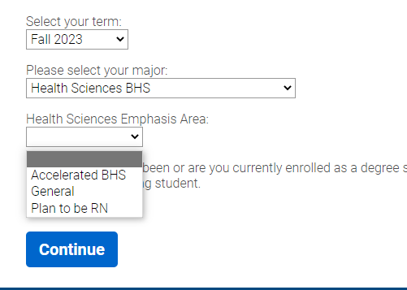
BSN Pre-Licensure Application Instructions
Supplemental Application
Are you a currently active UMKC student?
YES - You will need to log in and complete the application for fall 2026 Nursing BSN, NO –further information on future slides
see other options below.
Are you NOT a currently active UMKC student?
Pre-Licensure BSN applicants may still have a pre-requisite class or two that need to be completed at UMKC
Intro to Nursing/Intro to Health Sciences have few equivalent classes at other institutions.
You will need to create an application account and complete a new application for spring 2026 Health Sciences – BHS – with an emphasis area of “Plan to be RN”
Accelerated BSN applicants can complete all pre-requisites at another institution
If you want to take pre-requisites at UMKC, apply as Health Sciences – BHS with an emphasis area of “Accelerated BHS”
You must enroll and complete the UMKC specific pre-requisites by end of SP26 to be eligible for FS26 BSN.
Spring 2026
Fall 2024

Slide 3
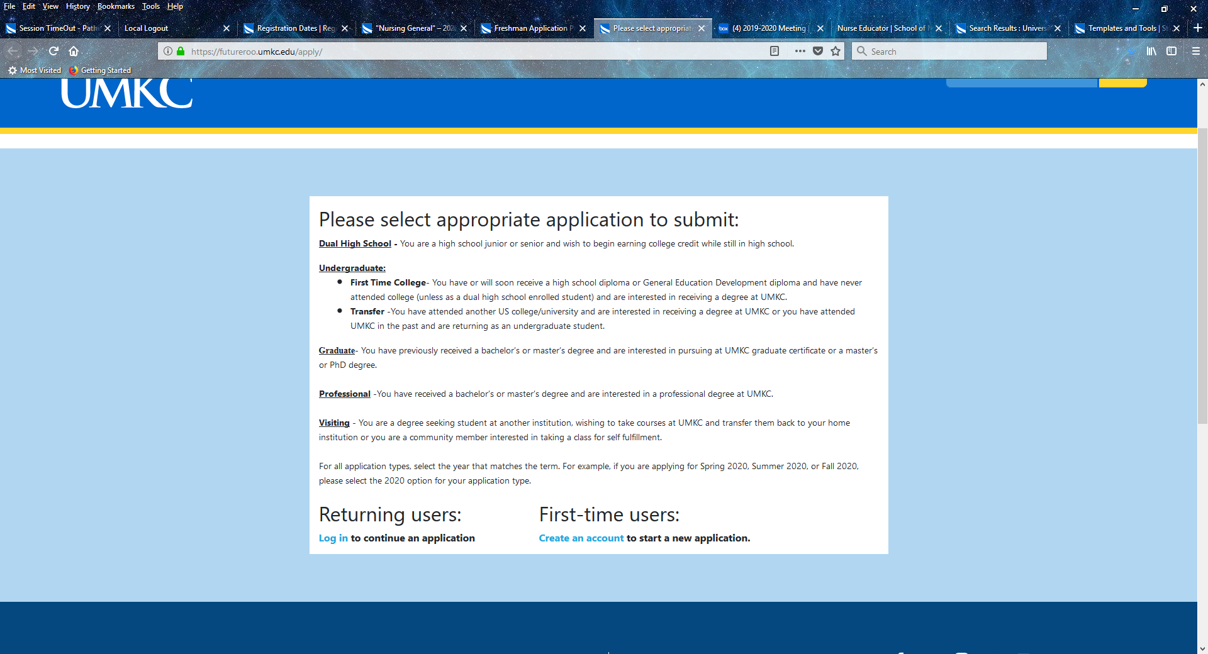
Login OR Create New Account
Visit UMKC Admissions
https://futureroo.umkc.edu/apply/
Define –
Returning Users:
If you have previously applied to UMKC. If you do not remember your sign-in, complete “forgot username/password” verification steps. If you do not have access to that email address any longer, complete First-time users.
First-time users:
If you have never applied to UMKC.

Slide 4
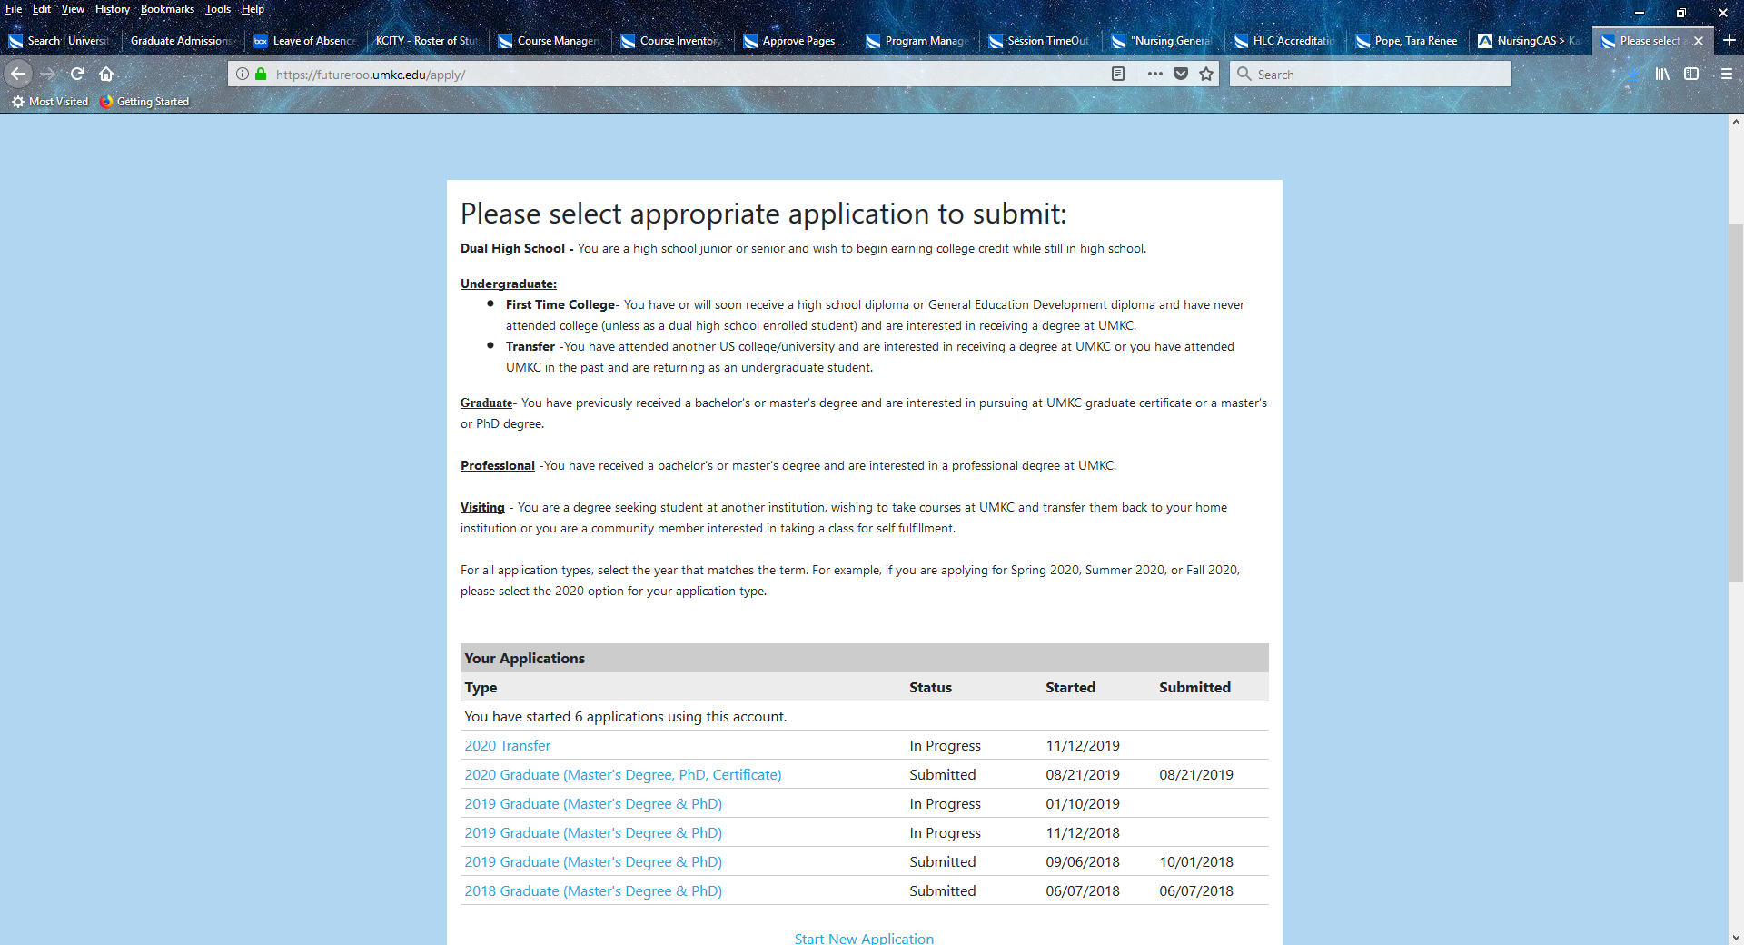
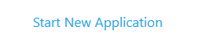
Opening a New Application
Click <Start a New Application>
Once you have logged in or created your account, you will see an informational page about each type of application.
At the bottom of the page, you can select ‘Start New Application’
If you have already started this application, it will appear in the ‘Your Applications’ section
ALL Pre-Licensure and Accelerated BSN Students will apply as ‘Transfer’,
even if you are a current UMKC student who originally applied as First Time College

Slide 5
Application Details Window
Once you have clicked ‘Start a New Application’ a new window will pop up.
On the Application Details Window - select the following:
“2026 Undergraduate”
“2026 Transfer”
Click <Create Application>
You will be able to open this application, close out, and access it again until the deadline of January 31, 2026.
To re-access the application this way, when you log in to your application account and check the ‘Your Applications’ section. Locate your in progress ‘2026 Transfer’ application and select ‘Open Application’
If you do not have the option to select ‘2026 Undergraduate’,
Contact Admissions at admissions@umkc.edu
If you have already submitted a UMKC application for the 2026 year (for example, our BHS Plan to be RN or BHS Accelerated programs) that may be why you cannot open an additional undergraduate application.
Admissions will be able to open this application for you, so that you can access it in the ‘Your Applications’ section.

Slide 6
BSN Application
Personal Information
If you have previously filled out a UMKC Application, this section may be pre-filled with the information you provided in your last application
If it is pre-filled, please read through to ensure all information is correct
If it is not pre-filled, please fill in this information and then click ‘continue’

Slide 7
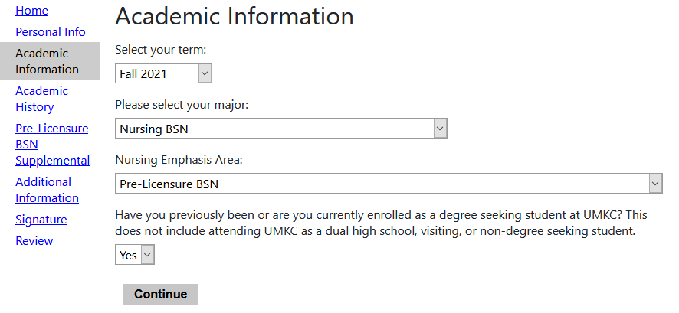
Academic Information
BSN Application
Reminder: Pre-Licensure BSN is for students with no prior Bachelor’s degree, Accelerated BSN is for students with a prior Bachelor’s degree OR their Bachelor’s degree will be completed by end of Spring 2026
Please ensure you select the correct emphasis.
You will select Fall 2026, Nursing BSN, Pre-Licensure BSN OR Accelerated BSN depending on your intended program
If you do not have the option Fall 2026/Nursing BSN/Pre-Licensure BSN or Accelerated BSN,
Alert Admissions at admissions@umkc.edu
This could be happening for a number of reasons including simply a technical issue – admissions will be able to help solve this issue for you.
Fall 2026
Please be sure to select 'yes' if currently enrolled

Slide 8
School Information/Academic History
BSN Application
This is where you will enter any past schools you have attended. If you have at least 24 credit hours of college credit, you do not need to enter high school information
This is also where you can upload unofficial transcripts. Please upload these if you have them as it helps your application move more smoothly through the review process while we wait on official copies to arrive.
Please note: If you have attended multiple higher education institutions, we will need official transcripts from each institution. For example, if you attend MU, but you previously attended MCC, we will need transcripts sent from both schools.
If MCC classes show on your MU transcript, we will still need official transcripts from both MU and MCC.

Slide 9
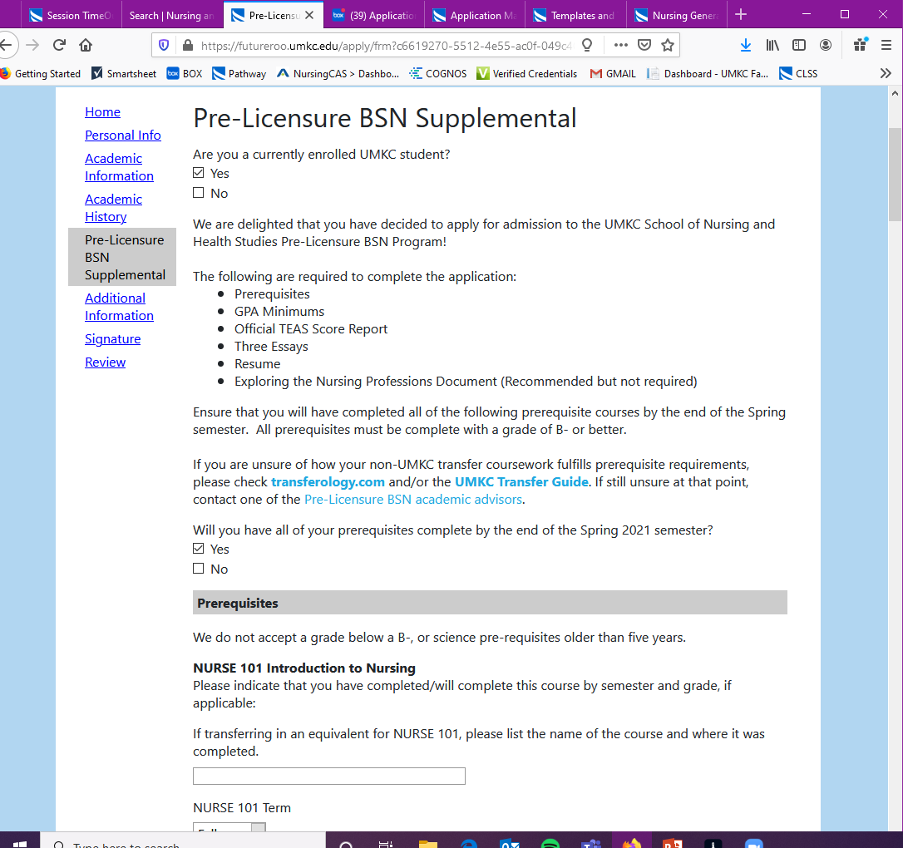
Pre-Licensure BSN
BSN Application
CURRENT STUDENTS:
If you will not have your pre-reqs completed by the end of the Spring 2026 semester, you are not eligible to apply for the Fall 2026 BSN cohort. Please reach out to your advisor for next steps:
Hannah Rodina – last names A-K (Hannah.Rodina@umkc.edu)
Jennifer Lyles – last names L-Z (jennifer.lyles@umkc.edu)
If you are an Accelerated BSN applicant, please keep scrolling
This is the Supplemental application for the BSN.
First step is to review the requirements and ensure all are completed.
Then, select ‘yes’ if your pre-requisites will be completed by end of Spring 2026
NON-CURRENT STUDENTS:
If you will not have your pre-reqs completed by the end of the Spring 2026 semester, you are not eligible to apply for the Fall 2026 BSN cohort. Please reach out to our office for next steps:
Nurses@umkc.edu
Spring 2026 Semester?

Slide 10
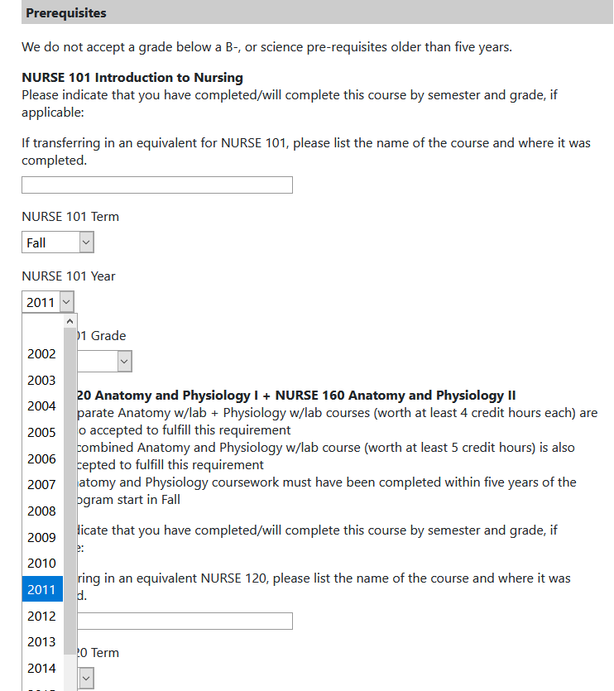
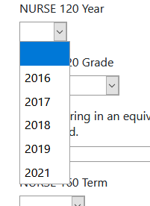
Pre-Licensure BSN
BSN Application
Please note the science pre-reqs only go back 5-years, as it is a requirement they are not older than five-years from when the program begins.
For our Fall 2026 BSN application, this means these classes cannot be older than Fall 2021.
Spring/Summer 2021 will not be accepted
If your Science classes are older than 5 years, you will need to retake them. If you cannot retake them before end of Spring 2026, you may need to wait to apply until next year.
CURRENT STUDENTS:
Contact your advisor for next steps:
Hannah Rodina – last names A-K (Hannah.Rodina@umkc.edu)
Jennifer Lyles – last names L-Z (jennifer.lyles@umkc.edu)
NON CURRENT STUDENTS:
Contact our office for next steps:
Nurses@umkc.edu
2020
2021
2022
2023
2024
2025

Slide 11
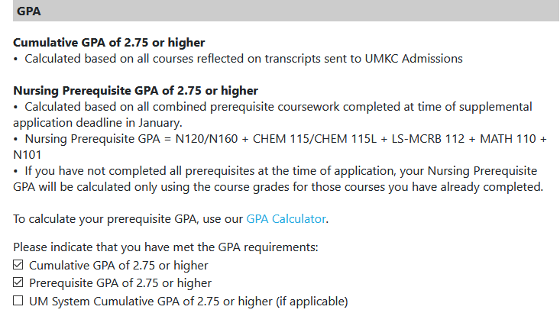
Pre-Licensure BSN
BSN Application
You will need to verify your GPA is 2.75 or higher. We look at 3 types of GPA
CUM GPA: all college credit
Pre-Requisite GPA: GPA of just pre-req classes
UM System GPA: GPA of just UM system schools
If you have any excluded courses on your transcripts that are not included in your GPA, UMKC will include those classes in your GPA when calculating
Not every student will have a UM system GPA. If you do not, just leave that box blank.
GPA calculator is an easy-to-use tool to help calculate your GPAs!
https://www.umkc.edu/registrar/student-records/grades-gpa/gpa-calculator.html

Slide 12
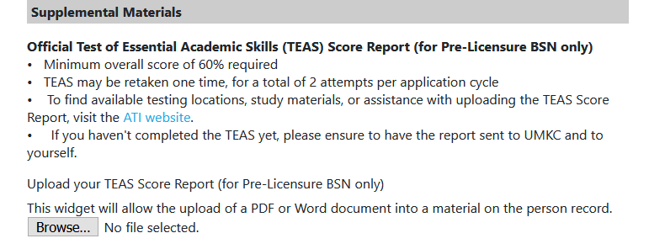
Pre-Licensure BSN
BSN Application
We will only look at the overall score, which must be 60 or higher
If you have already attempted twice, and have not achieved a score of 60 or higher, you must wait until next year to apply
If you do not have your TEAS results, please visit the ATI website and submit a request for results to be sent to you personally, then upload here.

Slide 13
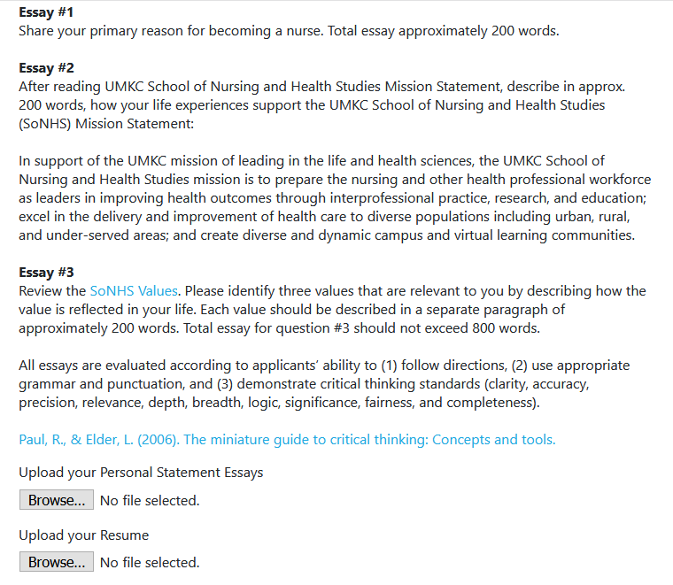
Pre-Licensure BSN
BSN Application
If you need assistance with your essays:
CURRENT STUDENTS:
You can utilize our Writing Center for help with grammar, punctuation, sentence structure, etc.
NON-CURRENT STUDENTS:
You may have writing resources at your current school, or you can ask friends/family/peers to read over your essays.
Important: Follow instructions on each essay, use appropriate grammar & punctuation and demonstrate critical thinking standards, and stay as close to word count as possible
If you need assistance with your Resume:
CURRENT STUDENTS:
You can utilize our career services center
NON-CURRENT STUDENTS:
Check out some Resume examples from UMKC BLOCH School:
https://cdn.careers.bloch.umkc.edu/wp-content/uploads/sites/130/2022/07/BlochUGResumeExamples-2022.pdf

Slide 14
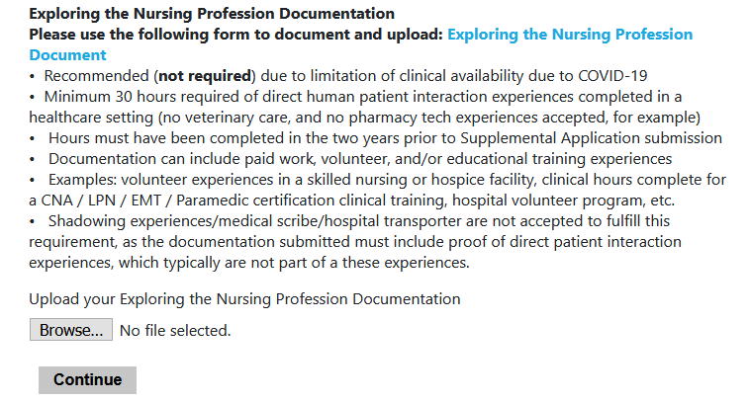
Pre-Licensure BSN
BSN Application
Exploring the Nursing Profession Documentation
Please use the following form to document and upload: Exploring the Nursing Profession
Minimum 30 hours required of direct human patient interaction experiences completed in a healthcare setting.
Hours must have been completed in the two years prior to the BSN application submission.
Documentation can include paid work, volunteer, and/or educational training experiences.
Examples: volunteer experiences in a skilled nursing or hospice facility, clinical hours completed for CNA/LPN/Paramedic certification, or a hospital volunteer program, etc.
Shadowing experiences with a nurse that provides direct patient care are accepted.
The following are NOT accepted: veterinary care, pharmacy technician experience, or hospital transporter as an example, as these do not include direct patient interaction.
Criteria for these hours:
Must take place in a healthcare setting
Must involve interaction with patients
Must have a RN somewhere present (even if they are just working on the floor you are volunteering on)
If any of this criteria is not met, but you still feel the experience may count for these hours, please email Nurses@umkc.edu and we can verify.
Important: This year the hours are REQUIRED. We encourage for those who do not have the hours completed or begun to reach out to nurses@umkc.edu for options within your community to obtain.
HOURS MUST BE DONE BY APPLICATION SUBMISSION.

Slide 15
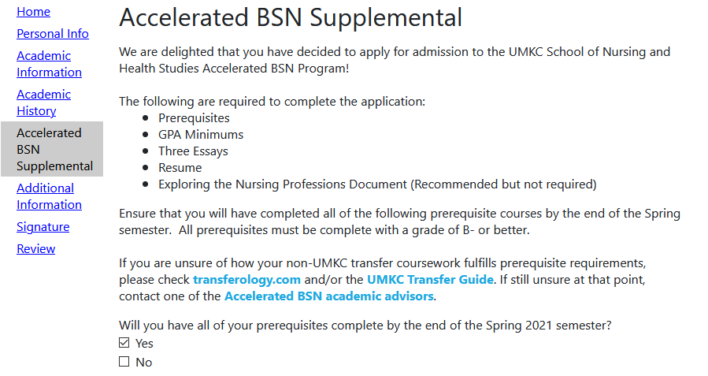
Accelerated BSN
BSN Application
CURRENT STUDENTS:
If you will not have your pre-reqs completed by the end of the Spring 2026 semester, you are not eligible to apply for the Fall 2026 BSN cohort. Please reach out to your advisor for next steps:
Hannah Rodina – last names A-K (Hannah.Rodina@umkc.edu)
Jennifer Lyles – last names L-Z (jennifer.lyles@umkc.edu)
If you are an Pre-Licensure BSN Applicant, please keep scrolling
This is the Supplemental application for the BSN.
First step is to review the requirements and ensure all are completed.
Then, select ‘yes’ if your pre-requisites will be completed by end of Spring 2026
NON-CURRENT STUDENTS:
If you will not have your pre-reqs completed by the end of the Spring 2026 semester, you are not eligible to apply for the Fall 2026 BSN cohort. Please reach out to our office for next steps:
Nurses@umkc.edu
Spring 2026 Semester?

Slide 16
Accelerated BSN
BSN Application
Please note the science pre-reqs only go back 5-years, as it is a requirement they are not older than five-years from when the program begins.
For our Fall 2026 BSN application, this means these classes cannot be older than Fall 2021.
Spring/Summer 2021 will not be accepted
If your Science classes are older than 5 years, you will need to retake them. If you cannot retake them before end of Spring 2026, you may need to wait to apply until next year.
CURRENT STUDENTS:
Contact your advisor for next steps:
Hannah Rodina – last names A-K (Hannah.Rodina@umkc.edu)
Jennifer Lyles – last names L-Z (jennifer.lyles@umkc.edu)
NON CURRENT STUDENTS:
Contact our office for next steps:
Nurses@umkc.edu
2020
2021
2022
2023
2024
2025

Slide 17
Accelerated BSN
BSN Application
You will need to verify your GPA is 2.75 or higher. We look at 3 types of GPA
CUM GPA: all college credit
Pre-Requisite GPA: GPA of just pre-req classes
UM System GPA: GPA of just UM system schools
If you have any excluded courses on your transcripts that are not included in your GPA, UMKC will include those classes in your GPA when calculating
Not every student will have a UM system GPA. If you do not, just leave that box blank.
GPA calculator is a easy-to-use tool to help calculate your GPAs!
https://www.umkc.edu/registrar/student-records/grades-gpa/gpa-calculator.html

Slide 18
Accelerated BSN
BSN Application
If you need assistance with your essays:
CURRENT STUDENTS:
You can utilize our Writing Center for help with grammar, punctuation, sentence structure, etc.
NON-CURRENT STUDENTS:
You may have writing resources at your current school, or you can ask friends/family/peers to read over your essays.
Important: Follow instructions on each essay, use appropriate grammar & punctuation and demonstrate critical thinking standards, and stay as close to word count as possible
If you need assistance with your Resume:
CURRENT STUDENTS:
You can utilize our career services center
NON-CURRENT STUDENTS:
Check out some Resume examples from UMKC BLOCH School:
https://cdn.careers.bloch.umkc.edu/wp-content/uploads/sites/130/2022/07/BlochUGResumeExamples-2022.pdf

Slide 19
Accelerated BSN
BSN Application
Exploring the Nursing Profession Documentation
Please use the following form to document and upload: Exploring the Nursing Profession
Minimum 30 hours required of direct human patient interaction experiences completed in a healthcare setting.
Hours must have been completed in the two years prior to the BSN application submission.
Documentation can include paid work, volunteer, and/or educational training experiences.
Examples: volunteer experiences in a skilled nursing or hospice facility, clinical hours completed for CNA/LPN/Paramedic certification, or a hospital volunteer program, etc.
Shadowing experiences with a nurse that provides direct patient care are accepted.
The following are NOT accepted: veterinary care, pharmacy technician experience, or hospital transporter as an example, as these do not include direct patient interaction.
Criteria for these hours:
Must take place in a healthcare setting
Must involve interaction with patients
Must have a RN somewhere present (even if they are just working on the floor you are volunteering on)
If any of this criteria is not met, but you still feel the experience may count for these hours, please email Nurses@umkc.edu and we can verify.
Important: This year the hours are REQUIRED. We encourage for those who do not have the hours completed or begun to reach out to nurses@umkc.edu for options within your community to obtain.
HOURS MUST BE DONE BY APPLICATION SUBMISSION.

Slide 20
BSN Application
Additional Information
If you have previously filled out a UMKC Application, this section may be pre-filled with the information you provided in your last application
If it is pre-filled, please read through to ensure all information is correct
If it is not pre-filled, please fill in this information and then click ‘continue’

Slide 21
BSN Application
Signature/Review
Please Review thoroughly that all information entered looks correct
Sign for accuracy
If any errors are appearing on your application that you can not figure out how to fix, please reach out to admissions@umkc.edu for assistance
This is the last section of the application. If all is complete, you can click submit!
Please do not wait until the last minute to submit your application if you can avoid it. Website traffic can slow the application page down, and can lead to some panic if you are waiting to submit right at the deadline.
If you run into any technical issues when trying to submit before deadline, please send an email to Nurses@umkc.edu immediately so that we can have email evidence that you were attempting to submit before deadline.

Slide 22
Timeline for Review
11/01/2025 Application became available
01/31/2026 Application deadline at midnight
04/2026 Initial round of decisions to students (prior to grades posting) – usually sent mid-end of April.
06/01/2026 Official decisions to students
Summer 2026 – Clinical Overview Session (mandatory)
08/2026 Success 4 Nursing (New BSN student orientation (mandatory)

Slide 23
Any Questions not answered in these instructions?
CURRENT STUDENTS:
Please contact your advisor
Hannah Rodina – last names A-K (Hannah.Rodina@umkc.edu)
Jennifer Lyles – last names L-Z (jennifer.lyles@umkc.edu)
NON-CURENT STUDENTS:
Please contact our office
Nurses@umkc.edu

