Slide 1
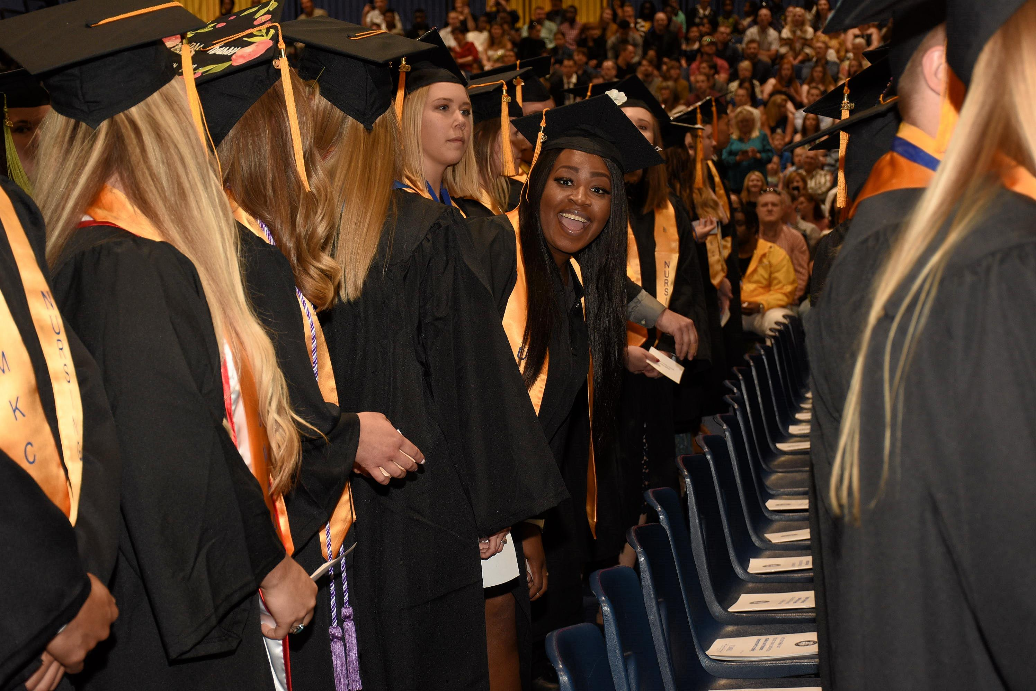
UMKC School of Nursing & Health Studies BSN Application is OPEN!
Now accepting applications to begin this Fall 2022
In the Bachelor of Science in Nursing Clinical Program
For Pre-Licensure & Accelerated applicants
Visit here to apply: https://www.umkc.edu/admissions/apply/index.html
Step-by-step instructions under “Advisor Forms”:
https://sonhs.umkc.edu/student-services/forms-and-resources.html

Slide 2
Supplemental Application
Are you a currently active UMKC student?
YES - You will need to log in and complete a new application for fall 2022 Nursing BSN.
NO – see other options below.
Are you NOT a current UMKC student, but need to enroll in pre-requisites and/or general education credit hours?
YES - You will need to log in and complete a new application for spring 2022 Health Sciences – BHS. Once this is submitted, alert us to ask that a fall 2022 BSN application become available to you (nurses@umkc.edu).
NO – see other option below.
Are you NOT a current UMKC student, and have ALL the pre-requisites completed, and only want to apply into the BSN program for fall 2021?
YES – You will need to create an account and start an application for fall 2022 Nursing BSN.

Slide 3
Login OR Create New Account
If you are already a UMKC student, login using your account information, OR create a new account~

Slide 4
Login OR Create New Account
Visit UMKC Admissions
https://futureroo.umkc.edu/apply/
Define –
Returning Users:
If you have previously applied to UMKC. If you do not remember your sign-in, complete “forgot username/password” verification steps. If you do not have access to that email address any longer, complete First-time users.
First-time users:
If you have never applied to UMKC.

Slide 5
Application Management
Click <Start a New Application>

Slide 6
Application Details Window
On the Application Details Window - select the following:
“2022 Undergraduate”
“2022 Transfer”
Click <Create Application> or <Open Application> if returning to complete in progress BSN application
The next page will ask Personal Information, then continue.
The following page is Academic Information.
Important: Select “On Campus” and “Fall 2022”.
Important: Select “Nursing BSN” for major
Important: Select Pre-Licensure (or Accelerated if you already have a four-year bachelor’s degree)
See next slide…
If you do not have the option to
Start a New Application,
Alert us at nurses@umkc.edu

Slide 7
Personal Information
Either confirm pre-filled information is correct, or fill in personal information and select <Continue>

Slide 8
Academic Information (Important)
Select Term – Fall 2022
Major – Nursing BSN
Emphasis – Pre-Licensure BSN OR Accelerated BSN (if already have a bachelor’s degree)

Slide 9
Academic Information
If you do not have the option Fall 2022/Nursing BSN/Pre-Licensure or Accelerated,
Alert us at nurses@umkc.edu.

Slide 10
Academic History
Answer any questions pertinent to previous institutions

Slide 11
BSN Supplemental
Important: You must have all pre-requisites completed by the end of the spring 2022 term in order to apply

Slide 12
Supplemental App
If you will not have your pre-reqs completed by the end of the Spring 2022 semester, you are not eligible to apply for the Fall 2022 BSN cohort. Please reach out to nurses@umkc.edu for next steps.

Slide 13
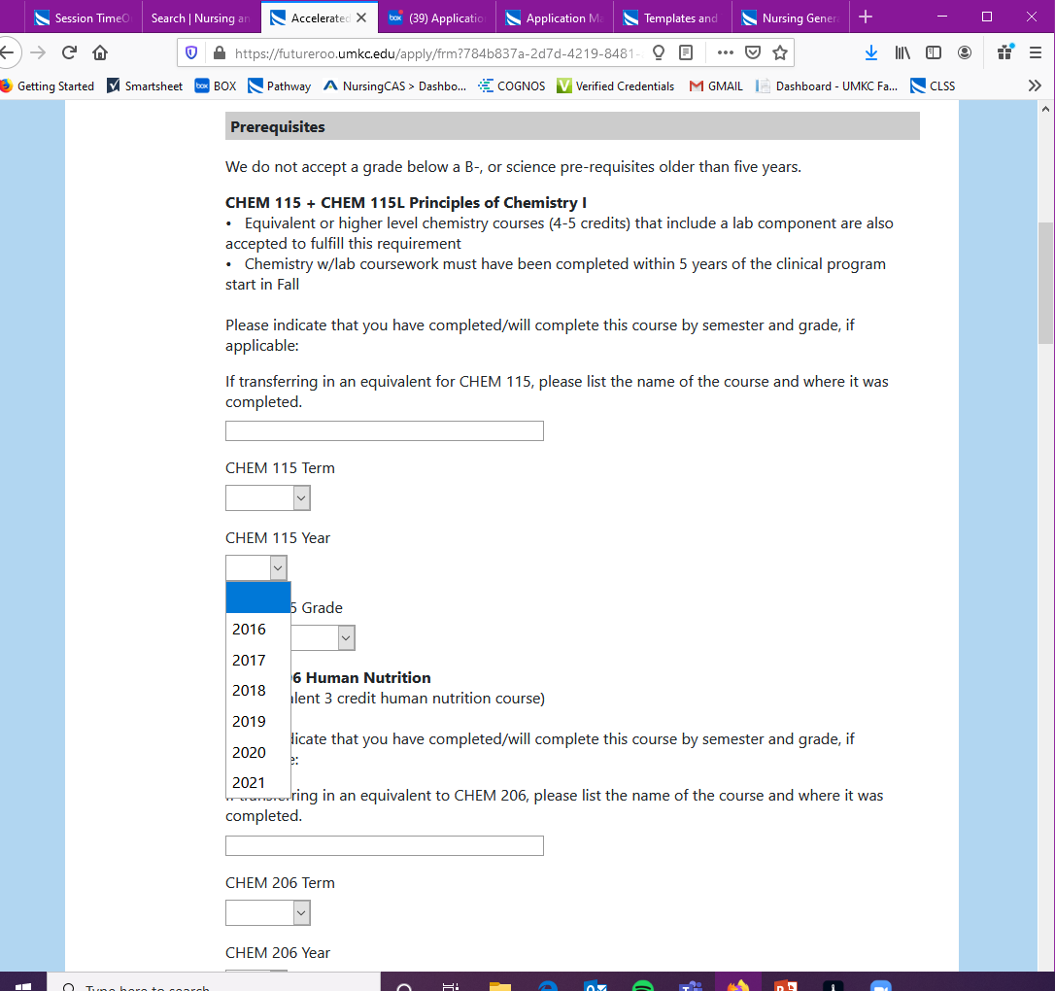
Supplemental App
Please note the science pre-reqs only go back 5-years, as it is a requirement, they are not older than five-years from when the program begins. If your year is not present, contact your advisor for next steps:
Lauren Newcomer – last names A-K (newcomerl@umkc.edu)
Jennifer Lyles – last names L-Z (lylesj@umkc.edu)

Slide 14
Supplemental App
GPA calculator is a easy-to-use tool to help calculate your GPAs!

Slide 15
Supplemental App
Important: Follow instructions on each essay, use appropriate grammar & punctuation and demonstrate critical thinking standards.

Slide 16
Supplemental App
Important: This year the hours are strongly recommended, but not required. We encourage for those who do have hours to touch on that in your essay somehow.

Slide 17
Additional Information
Continued general application questions

Slide 18
Signature/Review
Sign and review for accuracy

Slide 19
Submit!
We are so delighted you’ve chosen to apply with us!

Slide 20
Timeline for Review
11/01/2021 Application became available
01/31/2022 Application deadline at midnight
04/2022 Initial round of decisions to students
08/2022 Success 4 Nursing (New BSN student orientation)

Slide 21
Questions?
Email us at nurses@umkc.edu

